Slide 1
Emission Line Pipeline
Gabriella Quattropani

Slide 2
Pipeline Products
Stellar kinematics
Stellar continuum fits
Emission line gaussian fits
SAMI-like emission cubes

Slide 3
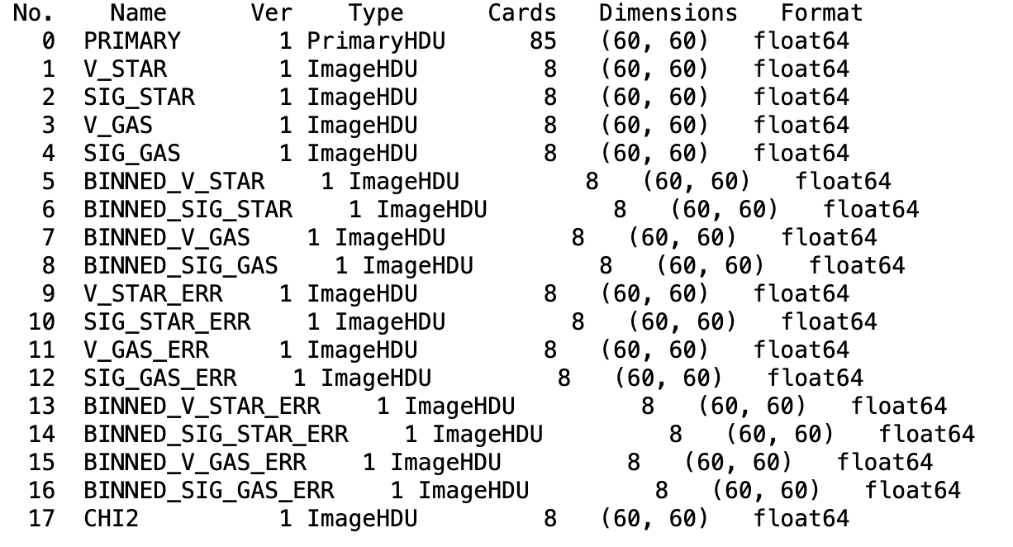
Stellar kinematics
Have binned and non-binned star and gas kinematics from pPXF.
Uses:
12-th order additive polynomial
X-shooter SSP Salpeter IMF and Padova00 isochrones
SN

Slide 4
Stellar continuum
Blue cube
Fit using pPXF.
Uses:
Stellar kinematics held fixed
12-th order multiplicative polynomial
X-shooter SSP Salpeter IMF and Padova00 isochrones
If SN < 5 ‘optimal’ template used – weighted sum of templates from ppxf run on binned spectra
If SN > 5 only templates with non-zero weights are used from run on binned spectra
Red cube
Primary = Stellar-continuum subtracted spectra

Slide 5
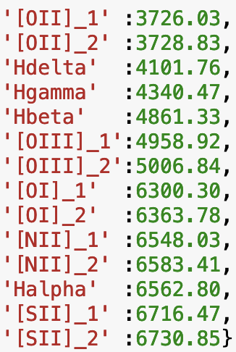
Gaussian Fitting
Levenberg-Marqaurdt fitting
Multiple fits with different initial guesses - best chosen through $χ^{2}$ statistic
All lines tied kinematically - next run can tie forbidden and balmer lines separately (Is this necessary for all galaxies?)
Flux ratios held at 3 for [OIII], [OI], [NII]
Some lines not fit due to gaps in spectra or due to redshift - currently fluxes are nan’d if this occurs. If the fit decides there is no component in that region the flux will be 0.0. Next run have bit-masking so we can immediately see which lines are not being fit. This varies spaxel to spaxel!

Slide 6
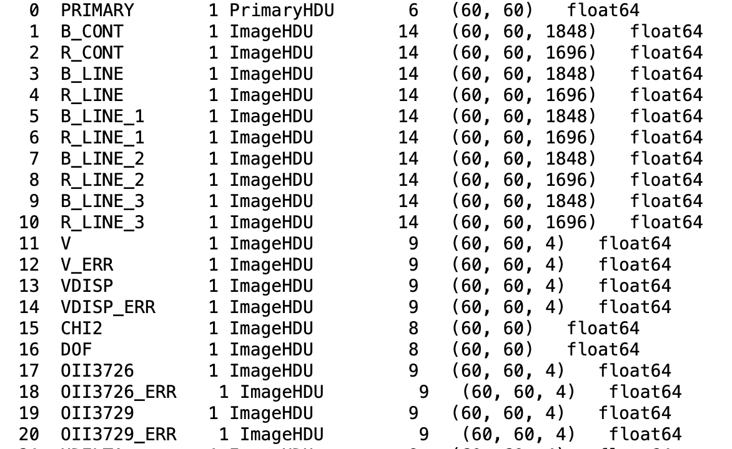
SAMI-like cubes
Currently 4 outputs: 1, 2, and 3-comp fits for each spaxel and recommended component fit using BIC
Can just use 1-comp fits but beware 2-comp/3-comp - only useful if you want to use your own ‘recommendation’ scheme i.e. something other than BIC. You rarely need 2nd and 3rd components in the outskirts of the bundle.
Recommended comp
Mask for which component to choose

Slide 7
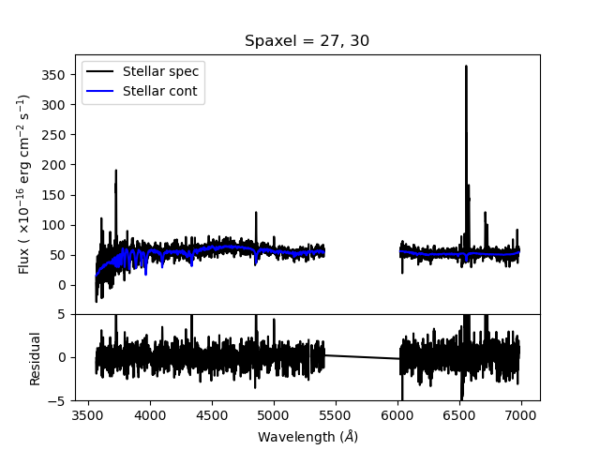
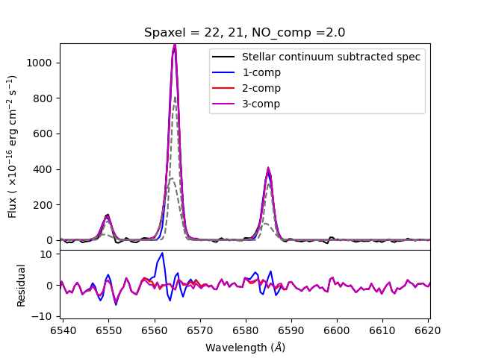
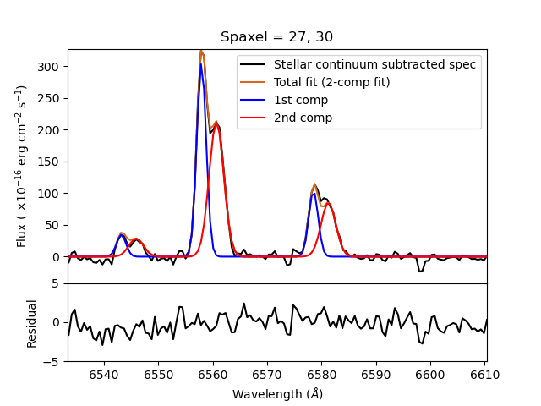
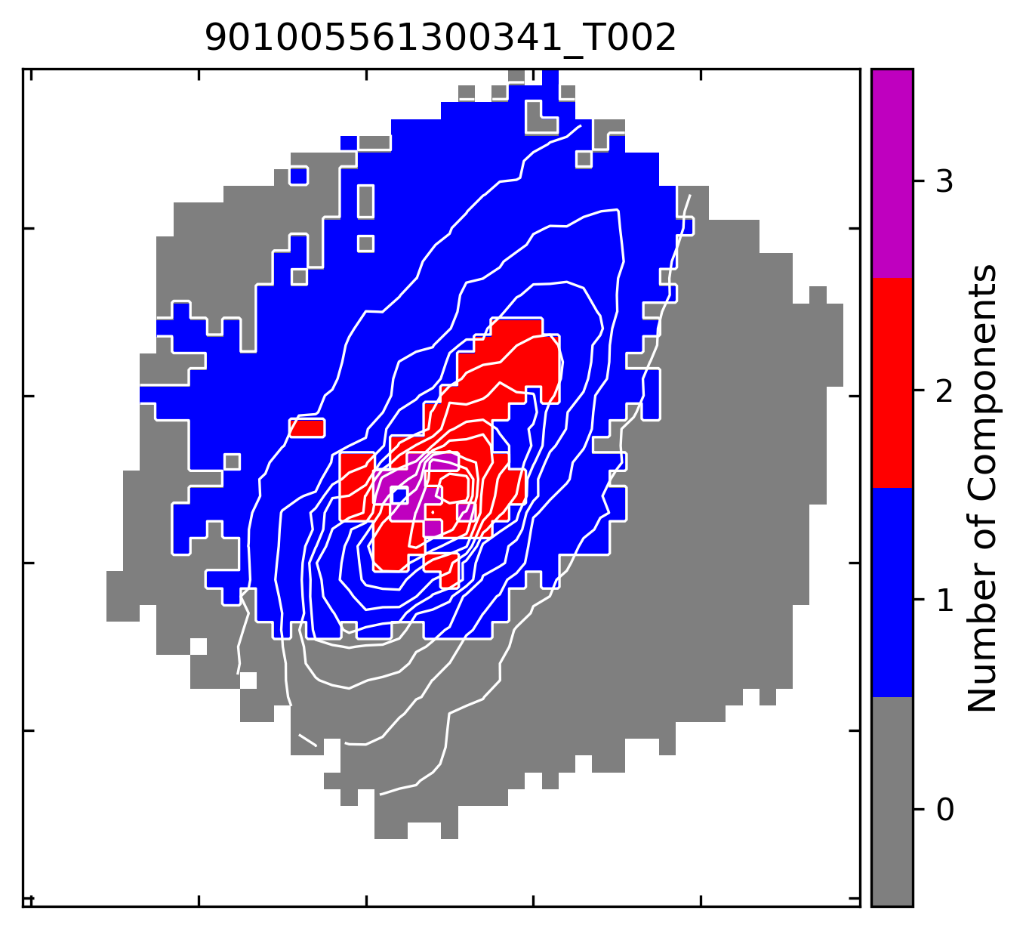
Good Fits

Slide 8
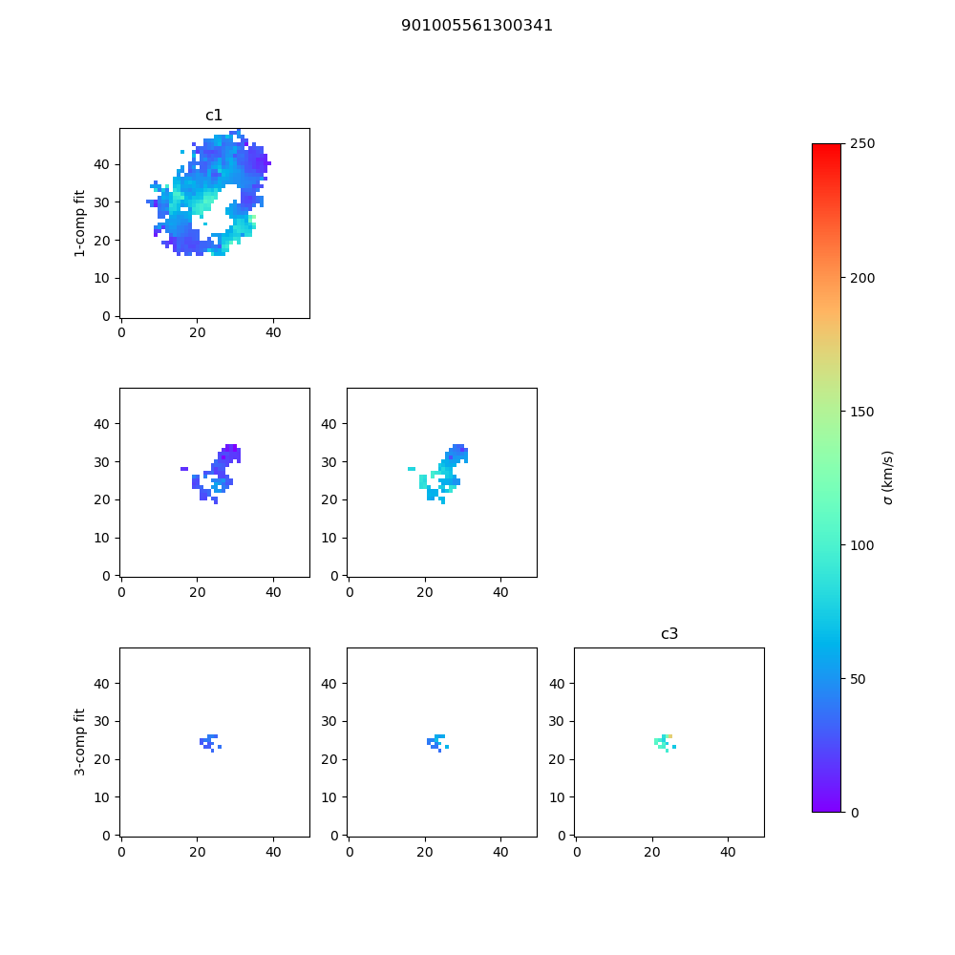
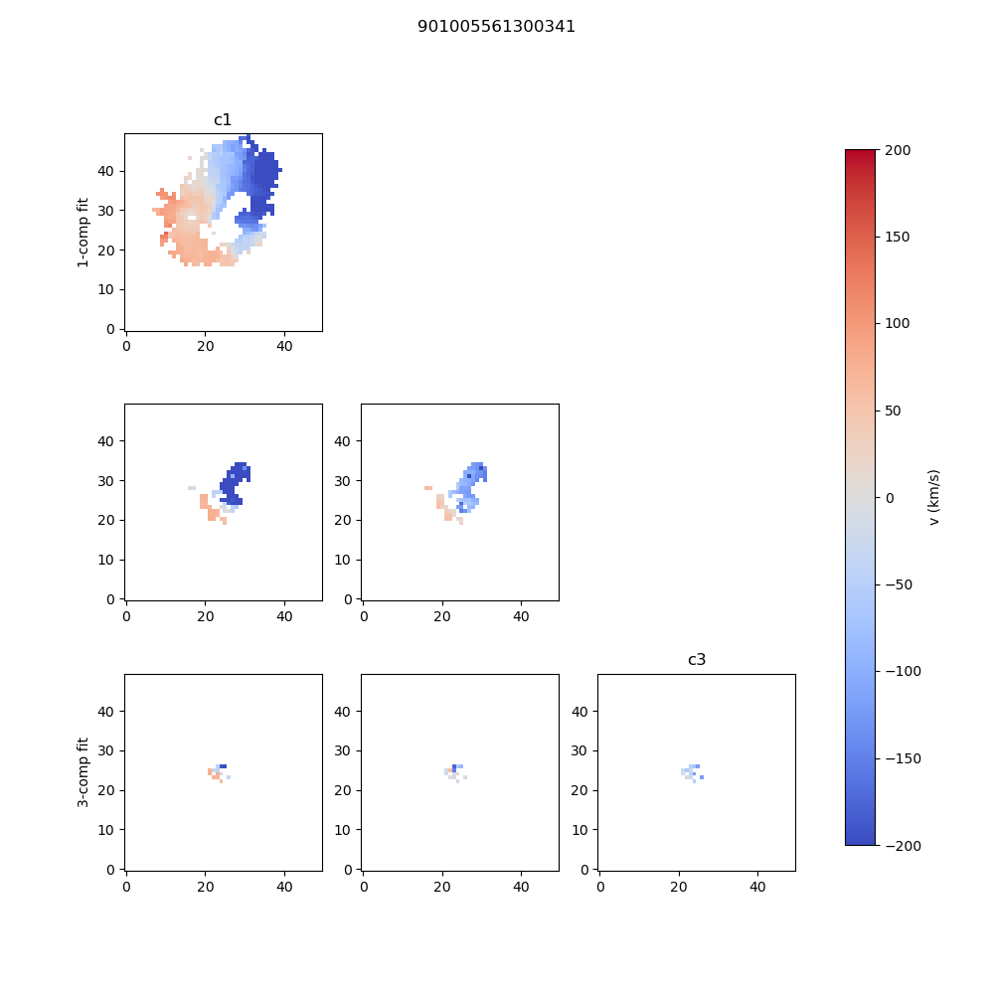
Parameter Maps

Slide 9
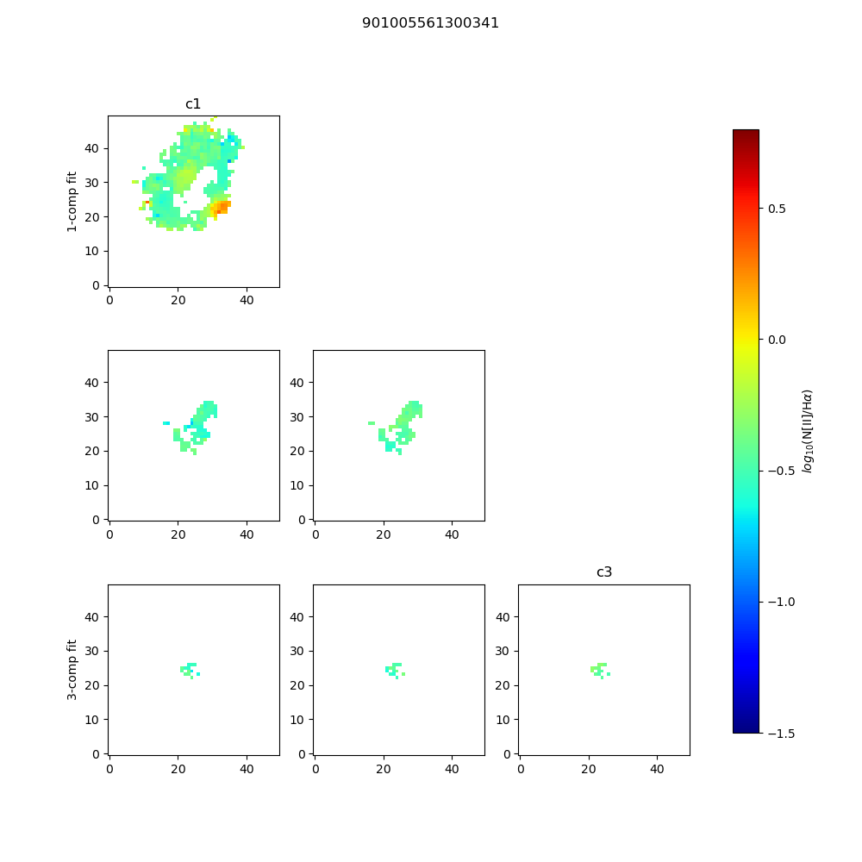

Slide 10
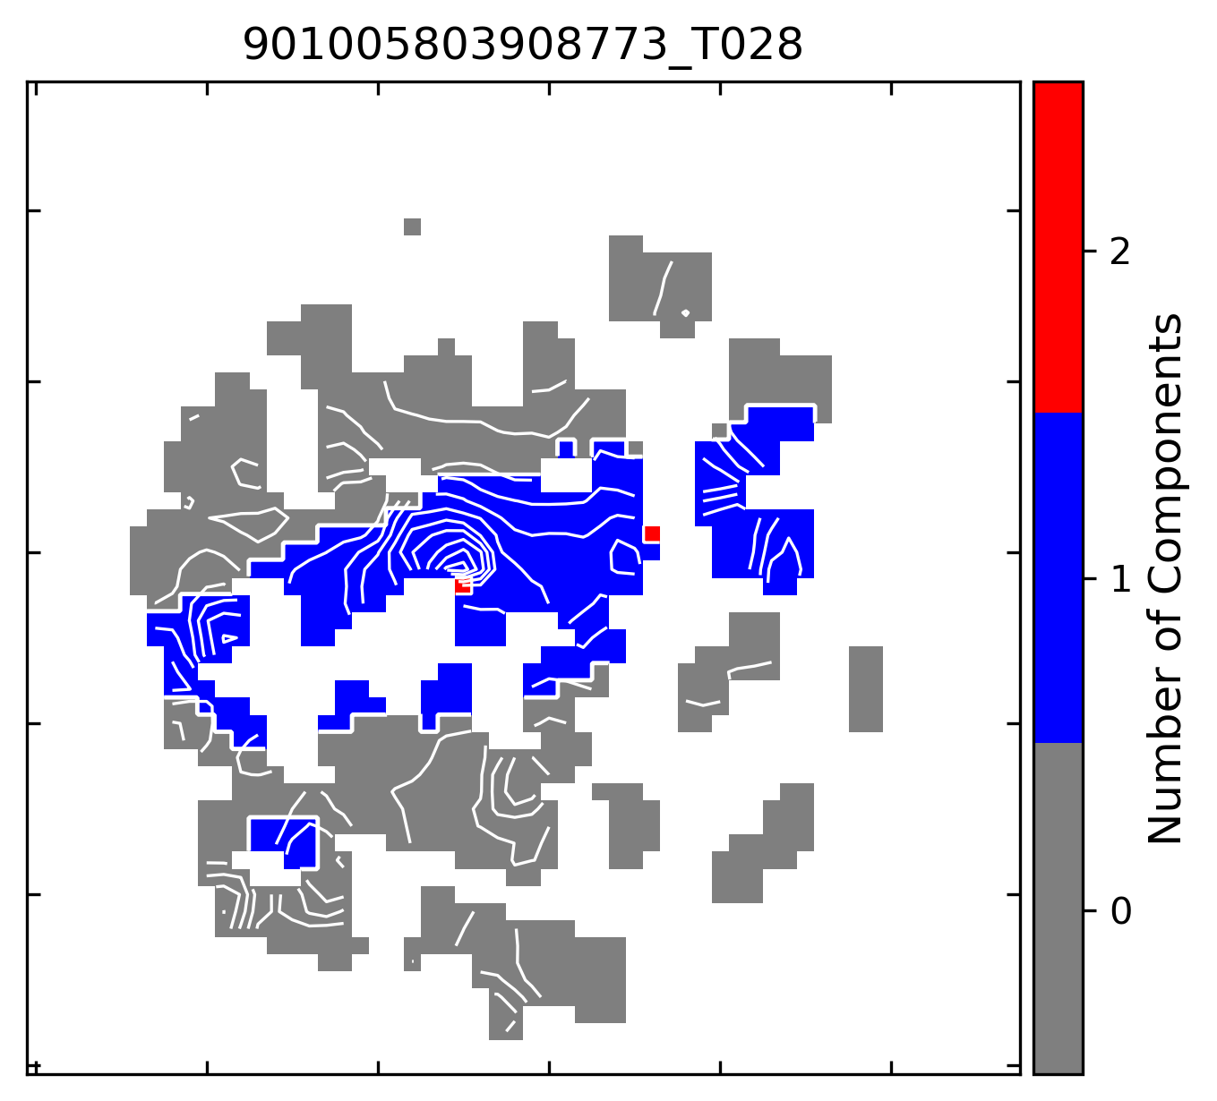
Potential Issues:
Cubes with gaps in maps
Cubes with gaps in spectra in various spaxels
Are the fits good/reasonable?
Cubes with no emission

